Slide 1
Portfolio SemperSystem Evolution

Slide 2
SemperSystem : Portfolio Programming – Build & Launch
Goal: Amplify Growth 50x
PY6 Q3 | Q1 2024
PY6 Q4 | Q2 2024
PY7 Q1 | Q3 2024
Presented PM approach at PY6 Q3 Offsite
Defined SemperSystem G8, New Investment & Wildcard approach
Designed Subjective & Objective scoring system for prioritizing companies
Ran beta SvS portfolio prioritization cycle
Launched Dock custom collab portals with founders
Focused platform on tracking and driving ARR
Ran first full SvS portfolio prioritization cycle & success plan deployment
Launched Portfolio Dashboard for tracking & reporting
Implemented quarterly SV team report
Implementation:
Discovery
Build & Launch
Workforce

Slide 3




SemperSystem : Portfolio Programming – Amplify at Scale
Goal: Amplify Growth 50x
PY7 Q2 | Q4 2024
Retro-active ARR reporting across Canopy | In-progress | $78M+ so far
Change management initiatives with portcos to drive outcomes reporting | Beta
Enhanced Portfolio dashboard & assets | In Build | Targeting: outcomes reporting gap analysis capabilities
"One-entry reporting" | In Build | Targeting Scale
CRM Dashboard
Centralized data capture
Reporting at scale
Interactive & Predictive Database
Interactive predictive work / gap analysis – super charging SemperSystem Insights
Predictive modeling to inform warrants
Amplified SemperSystem & Network
Targeted platform growth.
Enhanced Canopy value exchange impacts.
Iterate & Enhance
Scale
Executing retro-active reporting across Canopy
Initiated Change Management initiative with portfolio companies to drive consistent ARR & outcomes reporting
Enhanced Portfolio Dashboard targeting additional outcomes reporting (indirect ARR, Pipeline growth, etc.), gap analysis capabilities to identify additional SvS activations needed to fulfill Success Plans.
Additional enhancements for Scale in progress now -- Dashboard as source of truth - "one-click reporting & collaboration"

Slide 4
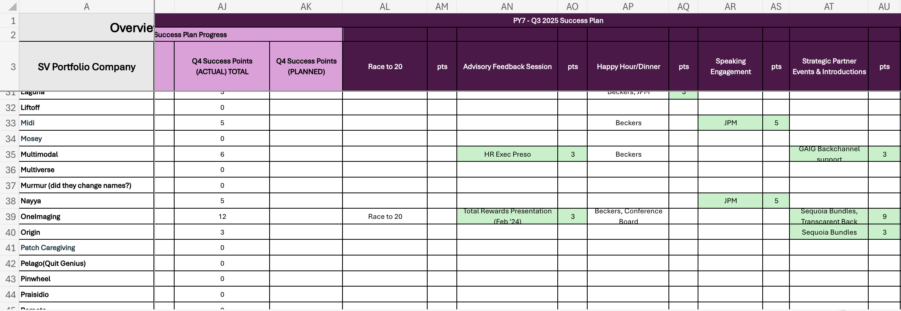
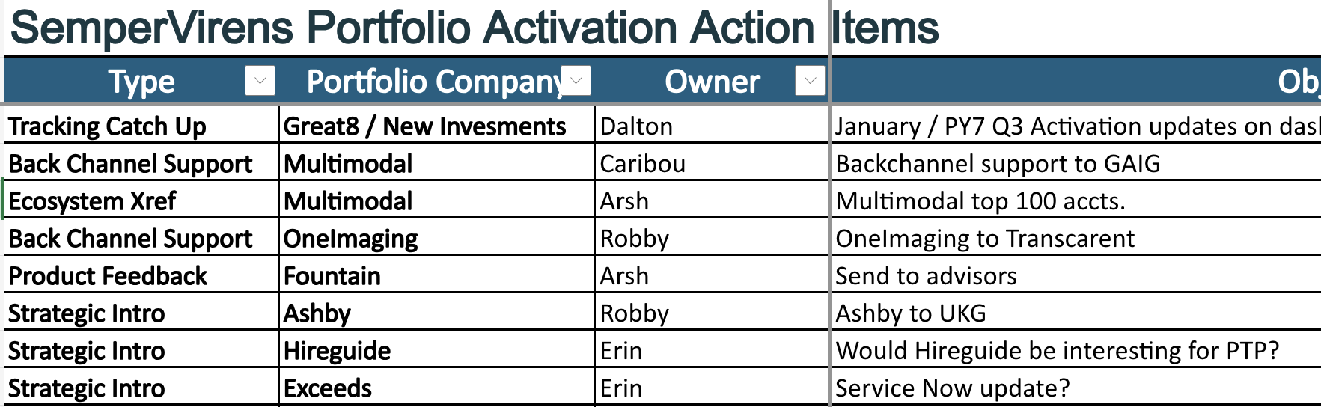

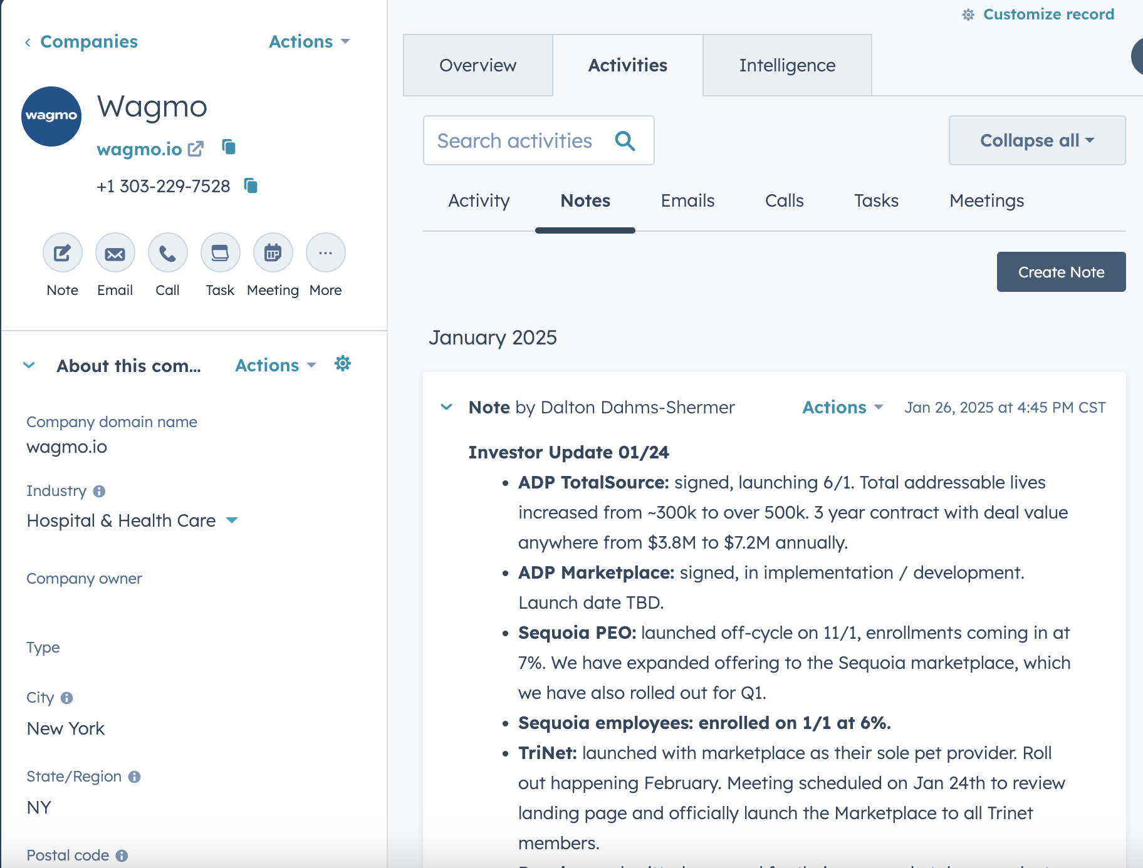
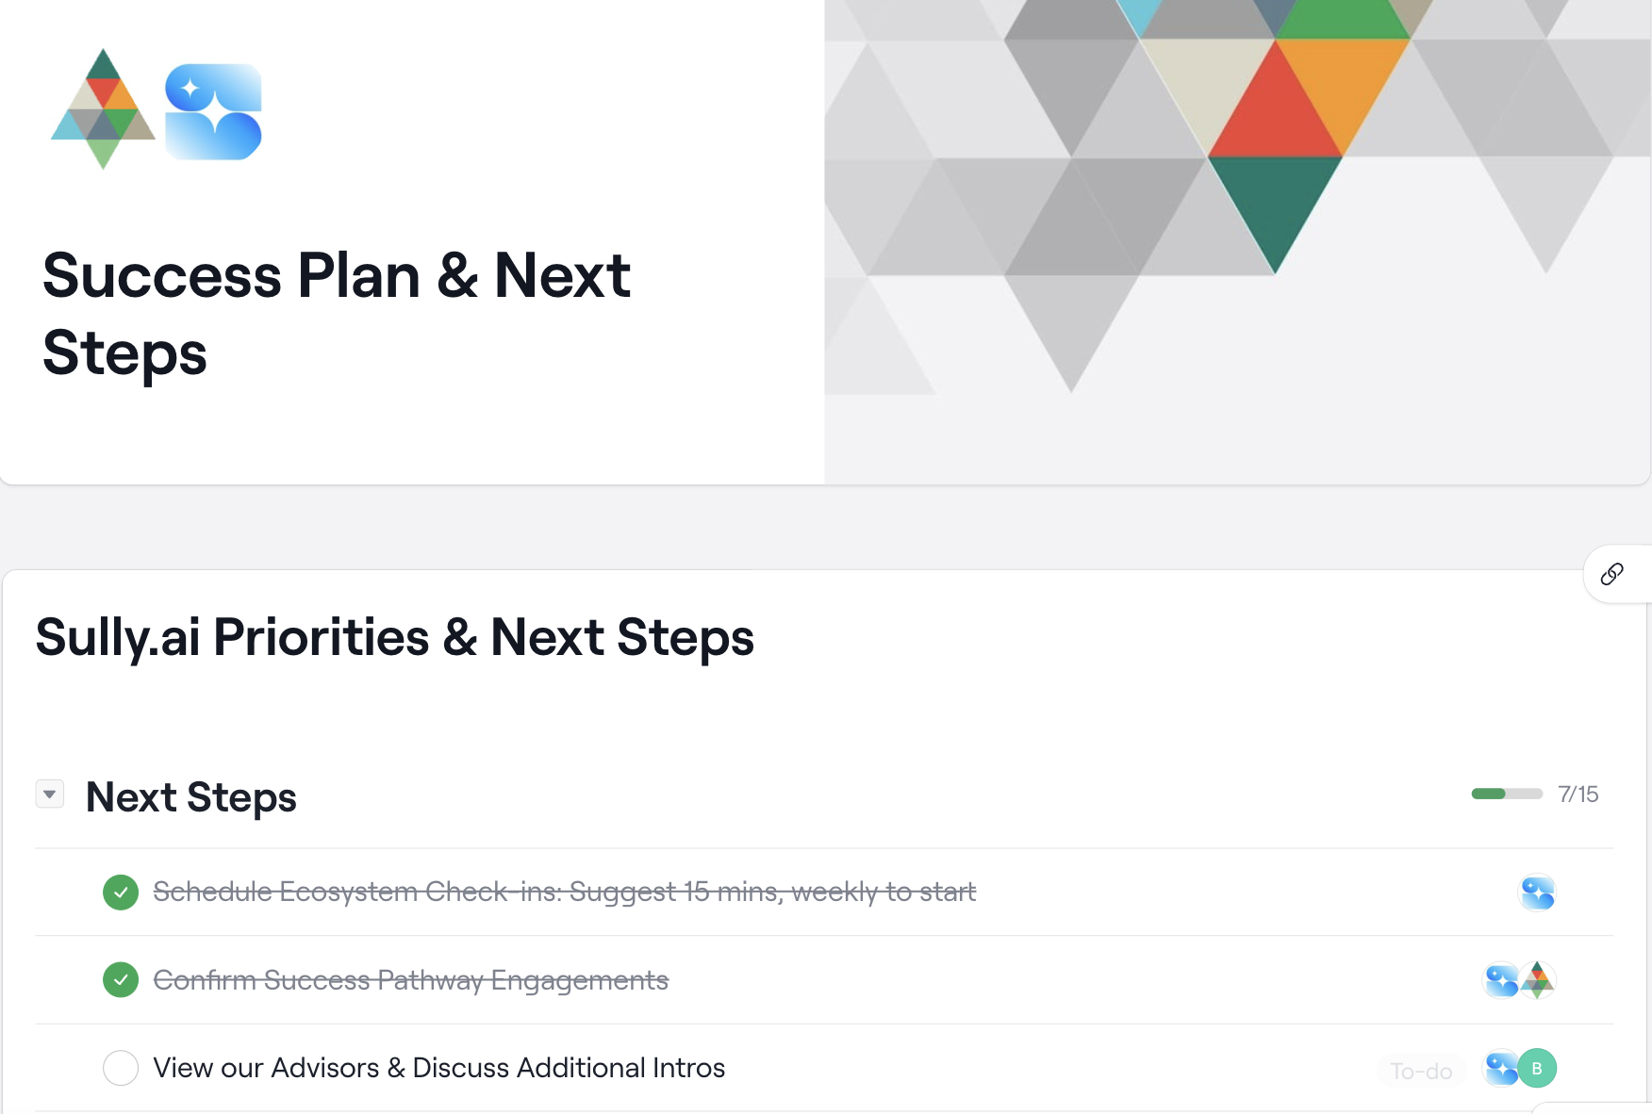


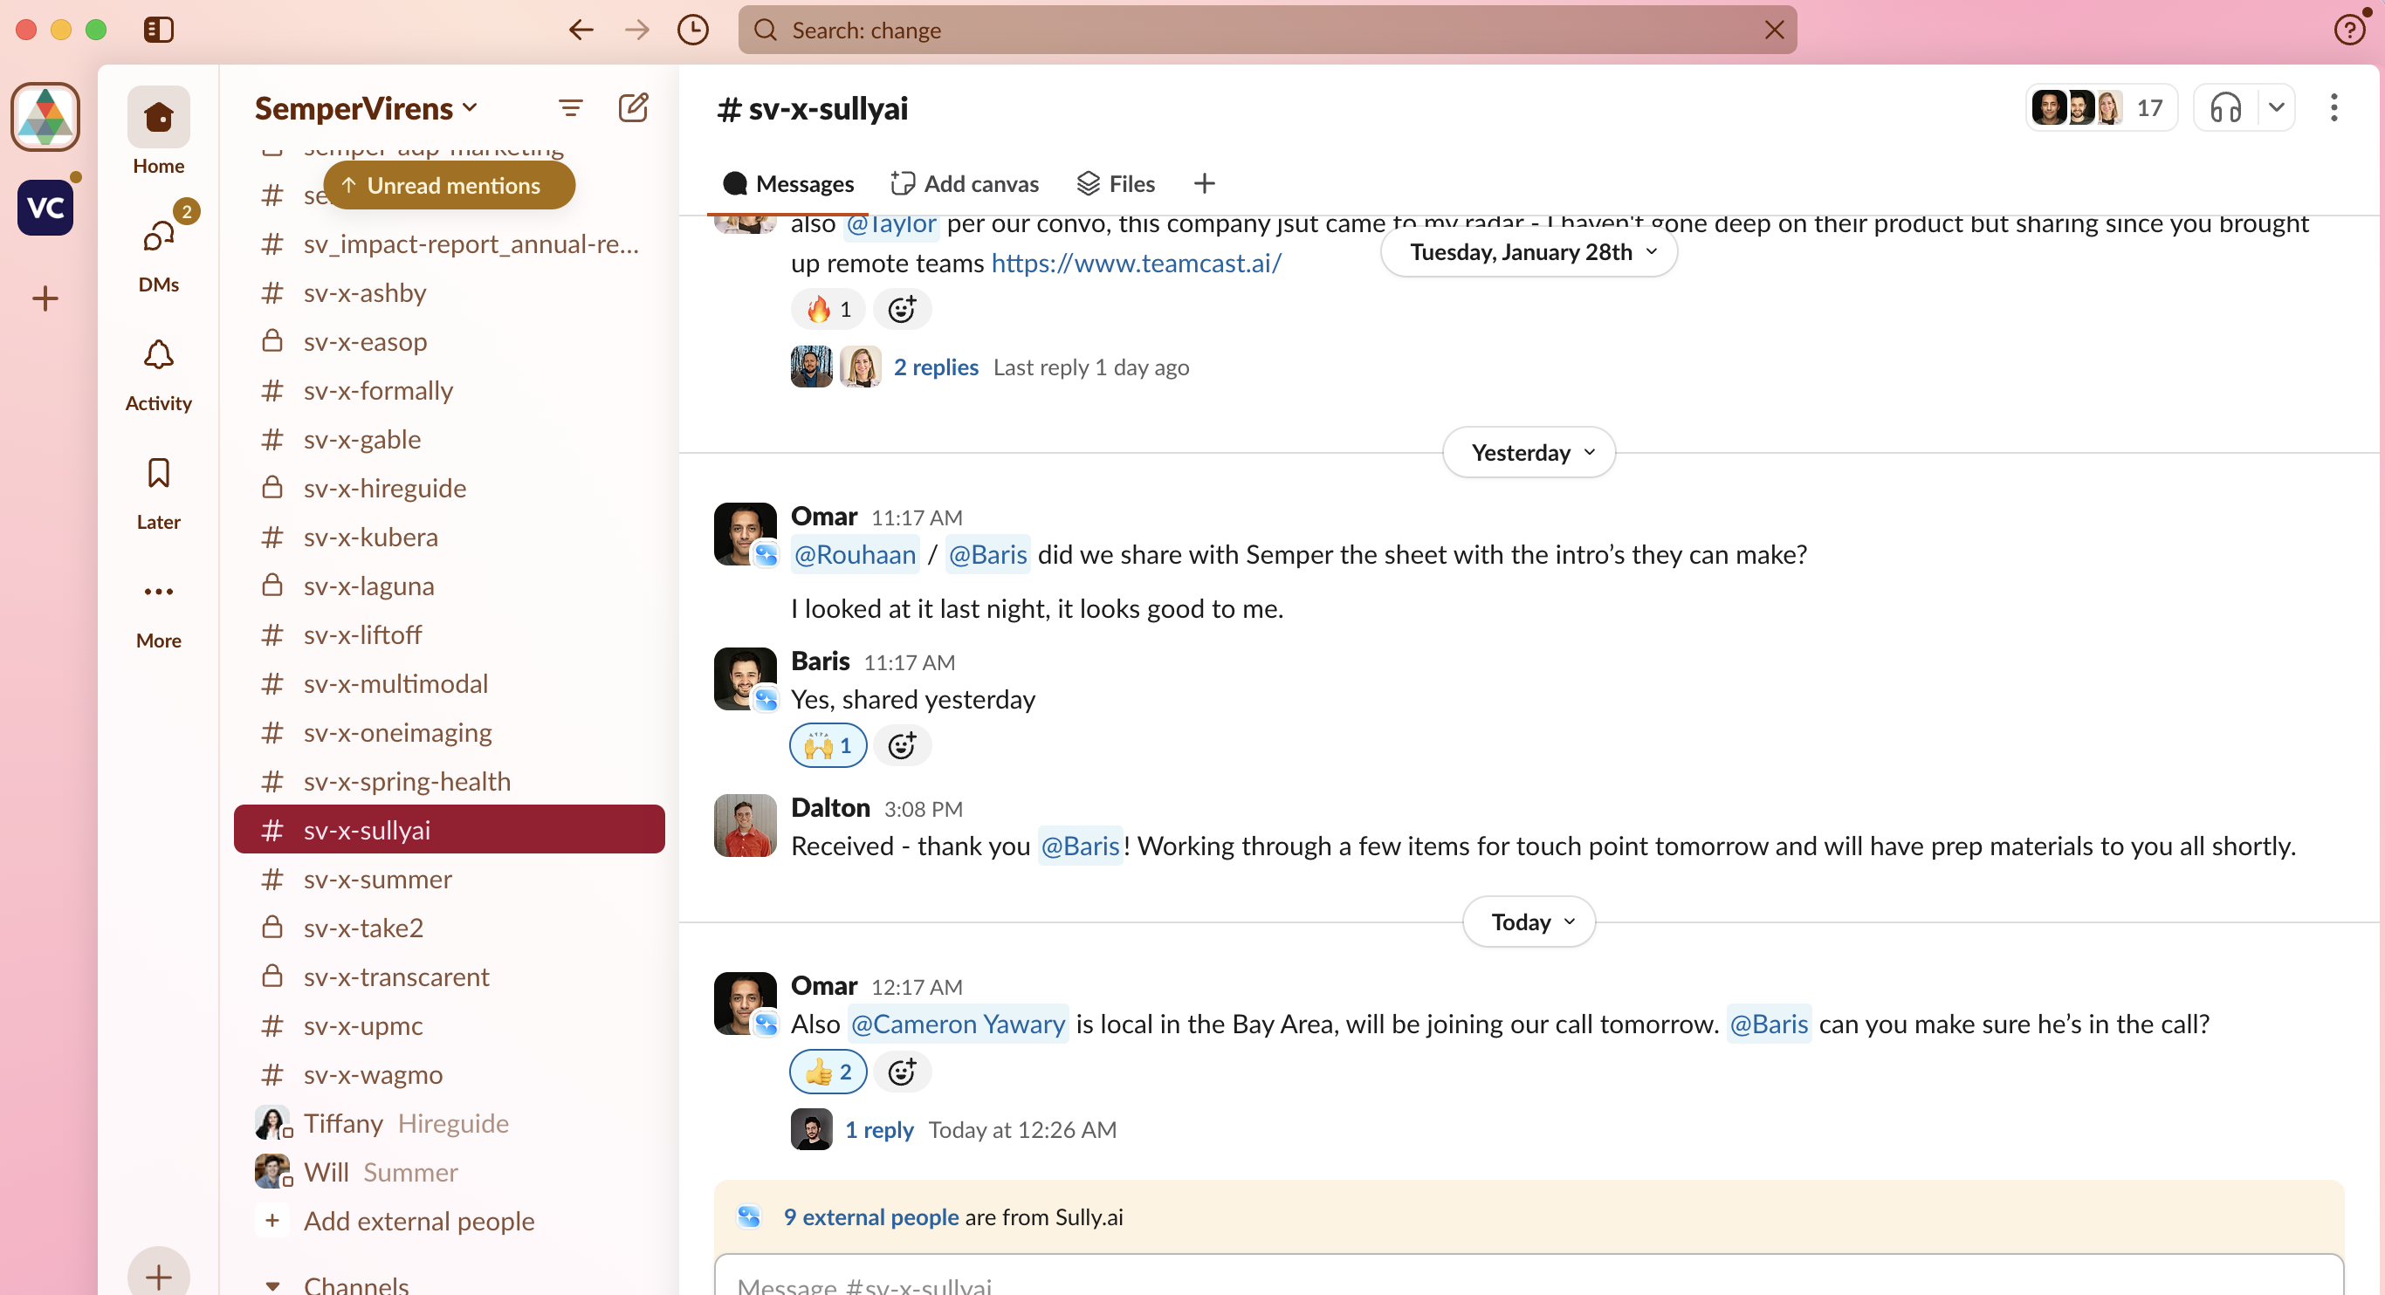

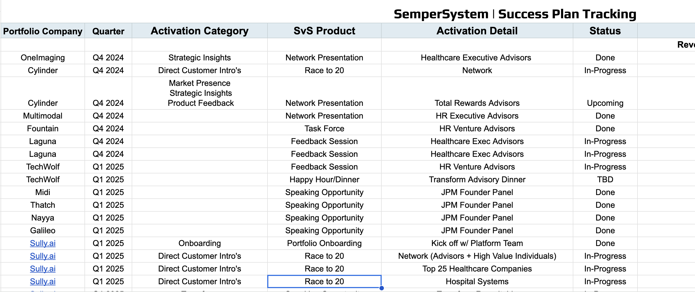
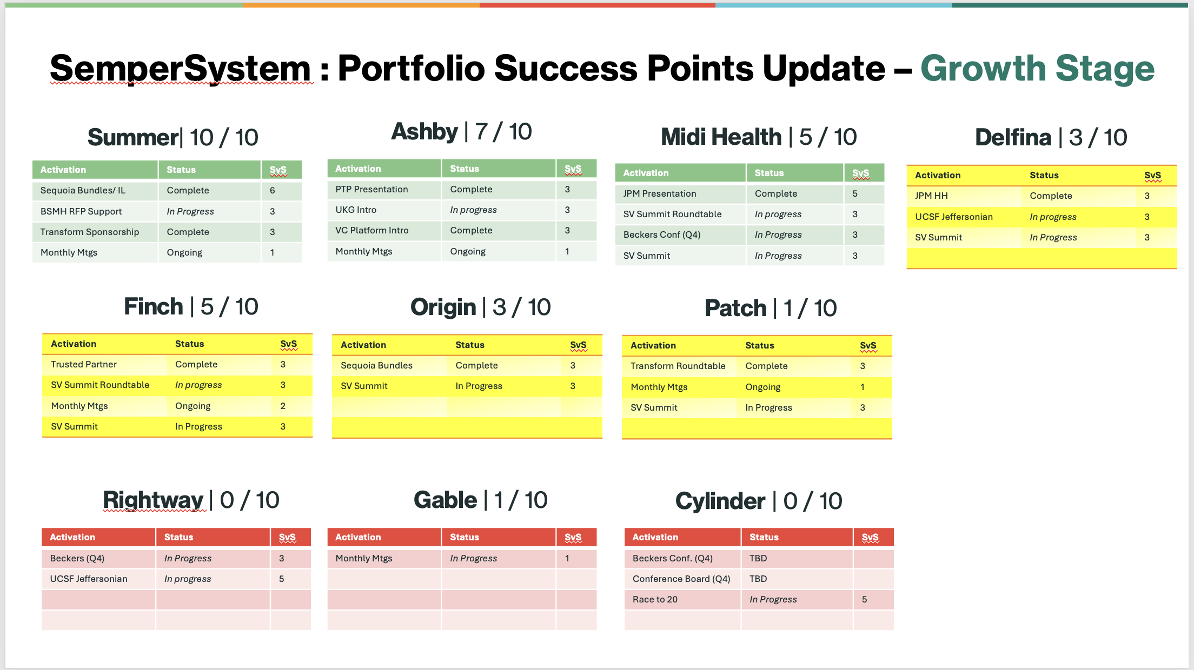


SemperSystem : State of Portfolio Reporting - Current
Tech | Use Case
 | Internal reporting Internal activation management Portfolio Dashboard
 | Record management
 | External management External activation management
 | External activation management Portfolio Dashboard
 | External/Internal activation management
Executing retro-active reporting across Canopy
Initiated Change Management initiative with portfolio companies to drive consistent ARR & outcomes reporting
Enhanced Portfolio Dashboard targeting additional outcomes reporting (indirect ARR, Pipeline growth, etc.), gap analysis capabilities to identify additional SvS activations needed to fulfill Success Plans.
Additional enhancements for Scale in progress now -- Dashboard as source of truth - "one-click reporting & collaboration"

Slide 5
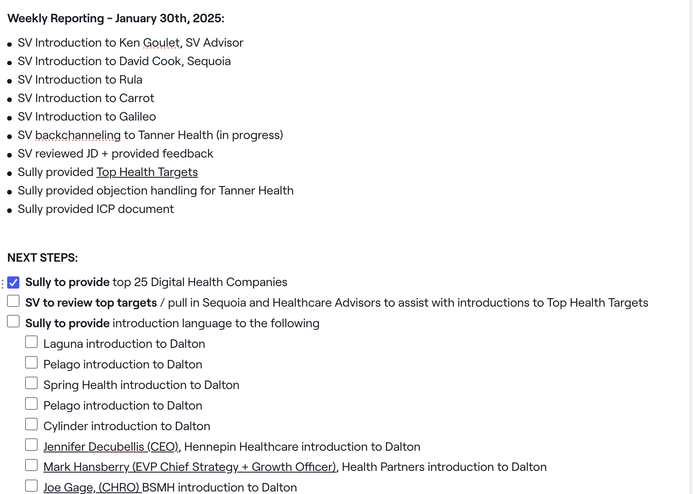
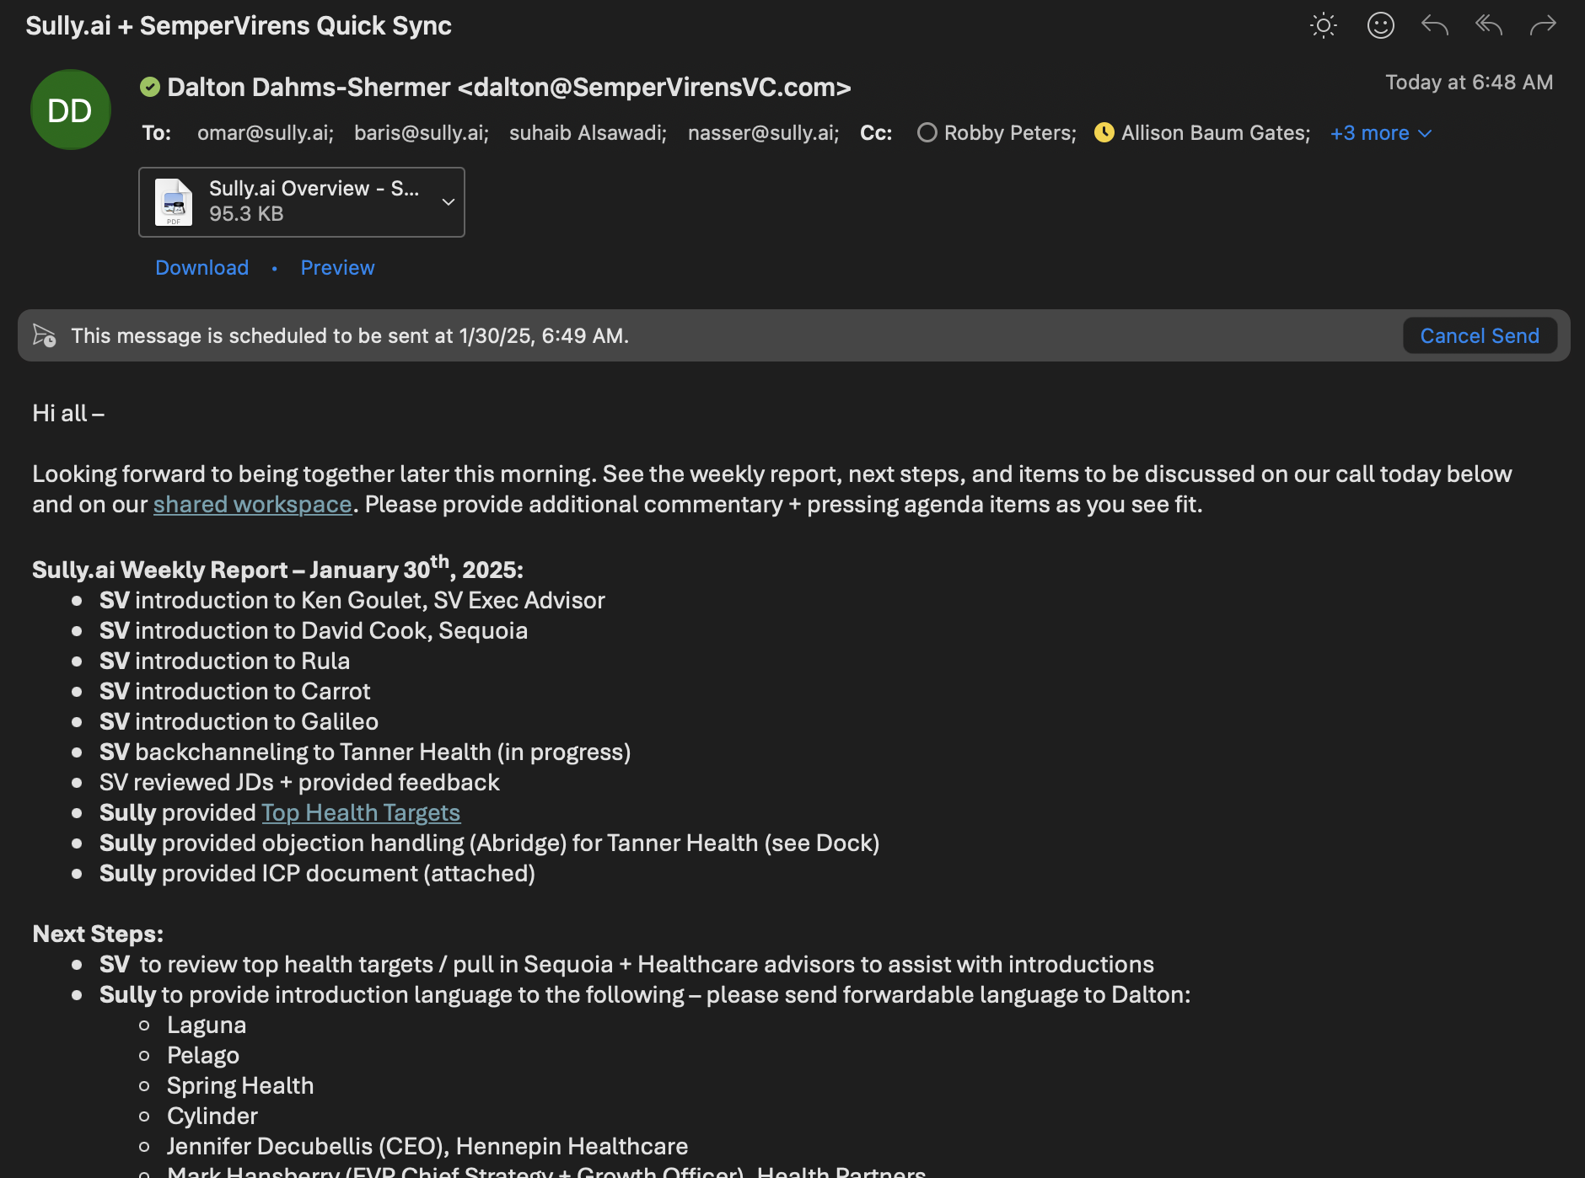
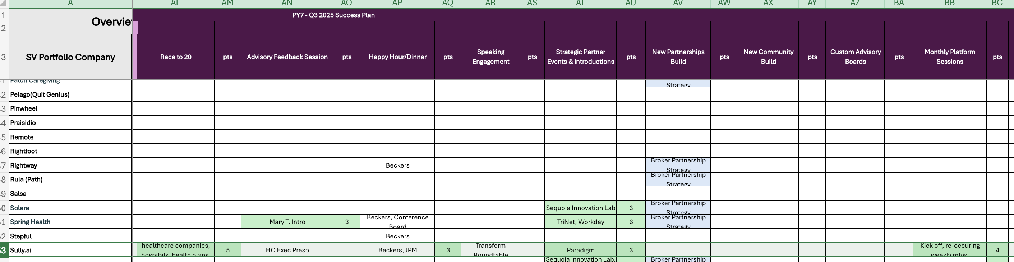
SemperSystem : State of Portfolio Reporting - Sully Example
Executing retro-active reporting across Canopy
Initiated Change Management initiative with portfolio companies to drive consistent ARR & outcomes reporting
Enhanced Portfolio Dashboard targeting additional outcomes reporting (indirect ARR, Pipeline growth, etc.), gap analysis capabilities to identify additional SvS activations needed to fulfill Success Plans.
Additional enhancements for Scale in progress now -- Dashboard as source of truth - "one-click reporting & collaboration"

Slide 6
SemperSystem : State of Portfolio Reporting – Short Term
Tech | Use Case
 | Remove from process, integrate with google sheets
 | Record management
 | External management External activation management
 | External activation management Internal reporting Internal activation management Portfolio Dashboard
 | External/Internal activation management
Questions:
Can we have ARR data on google sheets?
Executing retro-active reporting across Canopy
Initiated Change Management initiative with portfolio companies to drive consistent ARR & outcomes reporting
Enhanced Portfolio Dashboard targeting additional outcomes reporting (indirect ARR, Pipeline growth, etc.), gap analysis capabilities to identify additional SvS activations needed to fulfill Success Plans.
Additional enhancements for Scale in progress now -- Dashboard as source of truth - "one-click reporting & collaboration"

Slide 7
SemperSystem : State of Portfolio Reporting – Future
Executing retro-active reporting across Canopy
Initiated Change Management initiative with portfolio companies to drive consistent ARR & outcomes reporting
Enhanced Portfolio Dashboard targeting additional outcomes reporting (indirect ARR, Pipeline growth, etc.), gap analysis capabilities to identify additional SvS activations needed to fulfill Success Plans.
Additional enhancements for Scale in progress now -- Dashboard as source of truth - "one-click reporting & collaboration"

Slide 8
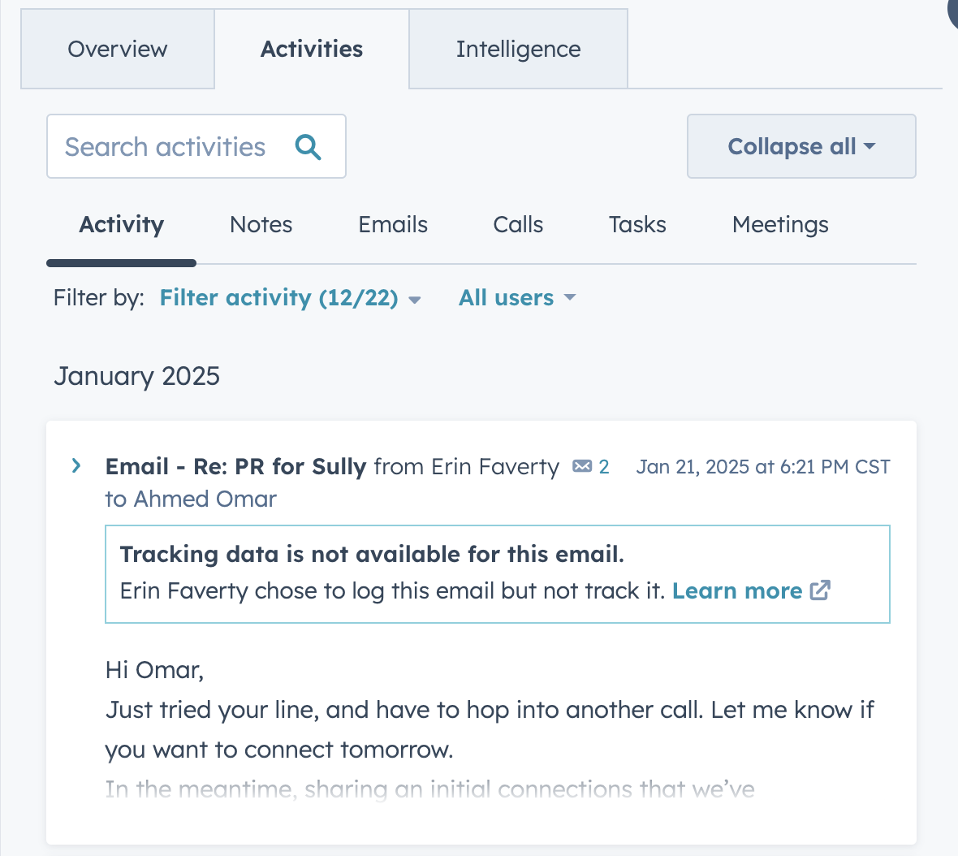
SemperSystem : State of Portfolio Reporting – Future
ARR
$4,662,038.00
Activation Points
35
Partnerships
12
Partnership Opportunities
10
Next Steps
Sully.ai to provide top 25 digital health companies assigned to Besar
SV to review top targets / pull in Sequoia and healthcare advisors to assist with introductions assigned to Dalton
Sully to provide introduction language to the following assigned to Omar
Executing retro-active reporting across Canopy
Initiated Change Management initiative with portfolio companies to drive consistent ARR & outcomes reporting
Enhanced Portfolio Dashboard targeting additional outcomes reporting (indirect ARR, Pipeline growth, etc.), gap analysis capabilities to identify additional SvS activations needed to fulfill Success Plans.
Additional enhancements for Scale in progress now -- Dashboard as source of truth - "one-click reporting & collaboration"

Slide 9
Portfolio SemperSystem ARR Reporting

Slide 10
SemperSystem : ARR Update
SemperSystem ARR Impact
Assumed + Unconfirmed Revenue PY1 - PY5) | Cumulative Revenue Impact | PY7 High Confidence Revenue (SV Direct) | PY7 Indirect Revenue Growth (ex. via network, Canopy) | PY7 Pipeline Revenue | PY6 High Confidence Revenue (SV Direct) | PY6 Indirect Revenue Growth (ex. via network, Canopy) | PY1 - PY5 Revenue
$23,897,000.00 | $81,648,603.09 | $5,576,618 | $3,527,420.40 | $9,910,445.00 | $3,347,284 | $15,029,972.00 | $44,256,864.09
Assumed + Unconfirmed Revenue PY1 – PY5:
Revenue that SemperVirens believes to have previously influenced in partnership deals during business operation years PY1 – PY5
Cumulative Revenue Impact:
Confirmed revenue generation from SemperSystem.
High Confidence Revenue:
Confirmed revenue generation from SemperSystem in PY7.
Indirect Revenue Growth:
Confirmed revenue generation from canopy & SemperVirens network in PY7.
Pipeline Revenue:
Pipeline high confidence or indirect revenue in SemperVirens portfolio pipeline in PY7.
Executing retro-active reporting across Canopy
Initiated Change Management initiative with portfolio companies to drive consistent ARR & outcomes reporting
Enhanced Portfolio Dashboard targeting additional outcomes reporting (indirect ARR, Pipeline growth, etc.), gap analysis capabilities to identify additional SvS activations needed to fulfill Success Plans.
Additional enhancements for Scale in progress now -- Dashboard as source of truth - "one-click reporting & collaboration"

Slide 11
SemperSystem : ARR Update
SemperSystem ARR Impact
Assumed + Unconfirmed Revenue PY1 - PY5) | Cumulative Revenue Impact | PY7 High Confidence Revenue (SV Direct) | PY7 Indirect Revenue Growth (ex. via network, Canopy) | PY7 Pipeline Revenue | PY6 High Confidence Revenue (SV Direct) | PY6 Indirect Revenue Growth (ex. via network, Canopy) | PY1 - PY5 Revenue
$23,897,000.00 | $81,648,603.09 | $5,576,618 | $3,527,420.40 | $9,910,445.00 | $3,347,284 | $15,029,972.00 | $44,256,864.09
PY7 Q3 | Q1 2025
ARR Growth
Confirmed Partnership Deals | Need ARR Reporting
Pending Partnership Deals | Q1 2025
Wagmo: +$773,000 (ADP Total Source/Marketplace, Sequoia PEO/Employees, TriNet, Guardian)
Carrot + Guardian
Ladder + Guardian
Origin + Guardian
Violet + BCBS CA
Summer + ADP
Finch + ADP
Nayya + Workday
Gable + Rippling
Gable + Remote
OneImaging + Sequoia
TechWolf + Workday – pending our influence
Cocoon + MetLife
Carrot + MetLife. ADP
Finch + Unum, MetLife
Midi + Cigna
Multimodal + GAIG, MetLife, Unum
Laguna + Fidelity, MetLife, Premera
Origin – Chubb, MetLife, Mastercard
Rula – Blue Ventures Fund
Spring Health – Highmark, TriNet, Workday
Stepful - Mercy Health System, Northwell, UPMC
Take2 – MetLife
Thatch - Blue Ventures Fund, Fidelity, MetLife,
Wagmo - Chubb, Unum, Prism, Paychex
XP Health – Unum
31 Pending Partnership Deals
Executing retro-active reporting across Canopy
Initiated Change Management initiative with portfolio companies to drive consistent ARR & outcomes reporting
Enhanced Portfolio Dashboard targeting additional outcomes reporting (indirect ARR, Pipeline growth, etc.), gap analysis capabilities to identify additional SvS activations needed to fulfill Success Plans.
Additional enhancements for Scale in progress now -- Dashboard as source of truth - "one-click reporting & collaboration"

Slide 12
SemperSystem Impact Update
Revenue Impact
Directly driving revenue growth for portfolio companies with a strong pipeline of strategic partnership opportunities in progress.
$5.9M confirmed ARR, tracking towards play year goal $10M
~$80M cumulative ARR impact
Recent: Wagmo, $773K
Cumulative Revenue Impact | PY7 High Confidence Revenue | PY7 Indirect Revenue Growth
$82,048,603.09 | $5,976,618 | $3,527,420.40
Strategic Partnerships & Distribution
SemperSystem has influenced 16+ distribution and channel partnerships this plan year
Guardian embeds Carrot in Hospital Indemnity product
Violet providing free cultural competence training for network providers at BCBS CA to support equitable healthcare for BIPOC, LGBTQ, and TGNC communities.
Finch enables seamless data connectivity between ADP and third-party HR or benefits platforms.
Tracking 30+ in progress partnerships this plan year
Executing retro-active reporting across Canopy
Initiated Change Management initiative with portfolio companies to drive consistent ARR & outcomes reporting
Enhanced Portfolio Dashboard targeting additional outcomes reporting (indirect ARR, Pipeline growth, etc.), gap analysis capabilities to identify additional SvS activations needed to fulfill Success Plans.
Additional enhancements for Scale in progress now -- Dashboard as source of truth - "one-click reporting & collaboration"

Slide 13
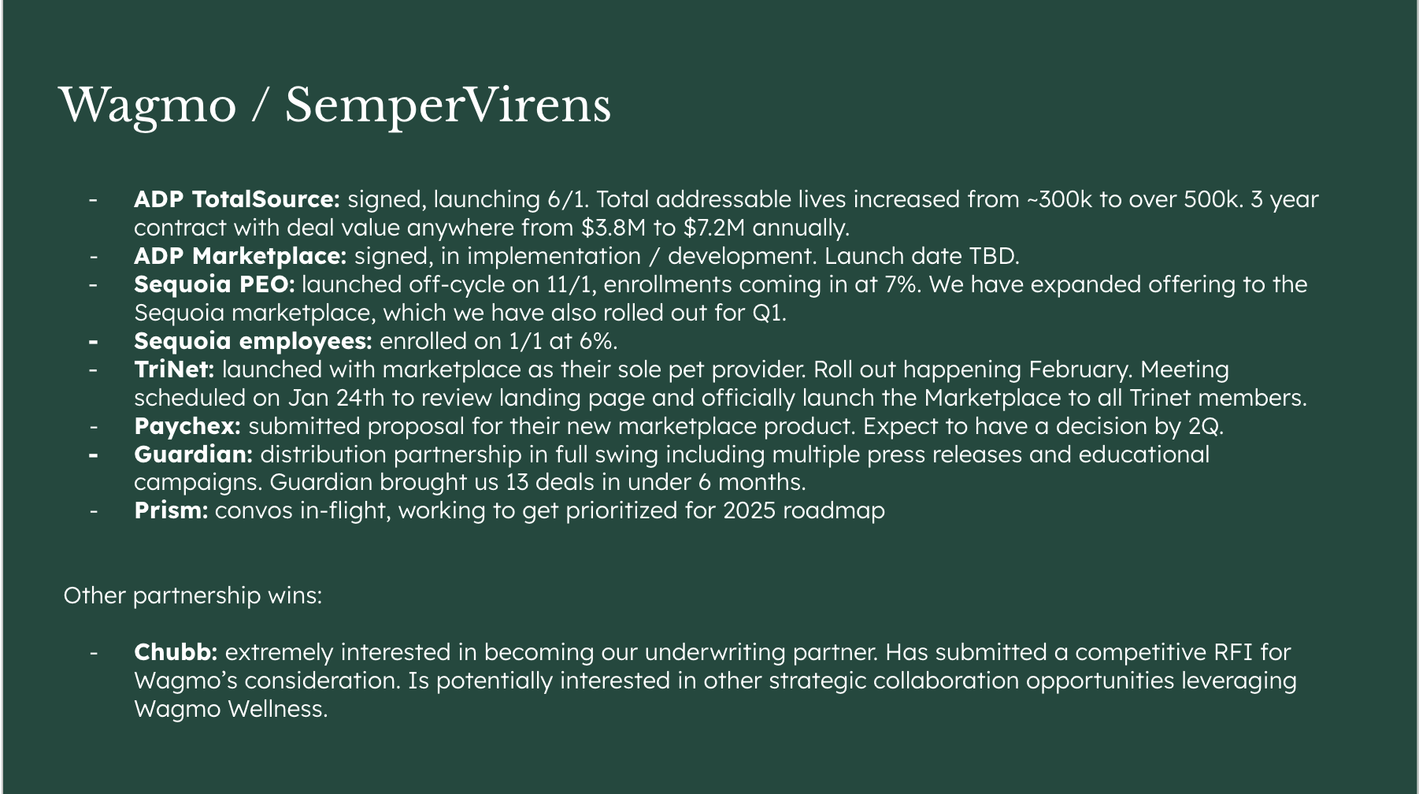
SemperSystem : Wagmo Case Study
Executing retro-active reporting across Canopy
Initiated Change Management initiative with portfolio companies to drive consistent ARR & outcomes reporting
Enhanced Portfolio Dashboard targeting additional outcomes reporting (indirect ARR, Pipeline growth, etc.), gap analysis capabilities to identify additional SvS activations needed to fulfill Success Plans.
Additional enhancements for Scale in progress now -- Dashboard as source of truth - "one-click reporting & collaboration"

Slide 14
SemperSystem : ARR Update
Overview | SemperSystem ARR Impact
SV Portfolio Company | Assumed + Unconfirmed Revenue PY1 - PY5) | Cumulative Revenue Impact | PY7 High Confidence Revenue (SV Direct) | PY7 Indirect Revenue Growth (ex. via network, Canopy) | PY7 Pipeline Revenue | PY6 High Confidence Revenue (SV Direct) | PY6 Indirect Revenue Growth (ex. via network, Canopy) | PY1 - PY5 Revenue
TOTALS | $23,897,000.00 | $81,648,603.09 | $5,576,618 | $3,527,420.40 | $9,910,445.00 | $3,347,284 | $15,029,972.00 | $44,256,864.09
A.Team | $200,000.00 |  |  | $- | $- | $- | $- | $-
Ashby | $- | $3,328,846.35 | $33,918.00 | $3,018,063.00 | $- | $224,046.60 | $- | $52,818.75
Bravely | $200,000.00 | $- |  | $- | $- | $- | $- | $-
Brightline | $- | $- | $- | $- | $- | $- | $- | $-
Brightside | $- | $- |  | $- | $- | $- | $- | $-
Carrot | $200,000.00 | $4,662,038.00 | $300,000.00 | $- | $- | $- | $4,362,038.00 | $-
Charthop | $1,000,000.00 | $- | $- | $- | $- | $- | $- | $-
Cleo | $- | $1,095,851.00 |  | $- | $- | $- | $1,095,851.00 | $-
Cocoon | $- | $1,819,415.00 | $- | $109,415.00 | $- | $- | $1,710,000.00 | $-
CoverGo | $- | $- |  | $- | $- | $- | $- | $-
Cylinder (frmr Vivante) | $- | $- | $- | $- | $- | $- | $- | $-
Delfina | $350,000.00 | $- | $- | $- | $- | $- | $- | $-
Exceeds.ai | $- | $- | $- | $- | $- | $- | $- | $-
Finch | $- | $- | $- | $- | $- | $- | $- | $-
Formally | $- | $- |  |  | $- | $- | $- | $-
Fountain | $6,000,000.00 | $- | $- | $- | $- | $- | $- | $-
Gable | $1,000,000.00 | $- | $- | $- | $- | $- | $- | $-
Galileo | $- | $388,077.00 |  | $- | $- | $388,077.00 | $- | $-
Hatch | $- | $- |  | $- | $- | $- | $- | $-
Hireguide | $- | $- |  | $- | $- | $- | $- | $-
Hone | $1,000,000.00 | $- | $- | $- | $- | $- | $- | $-
Human Interest | $- | $- |  | $- | $- | $- | $- | $-
Ianacare | $- | $- |  | $- | $- | $- | $- | $-
Karat | $- | $- | $- | $- | $- | $- | $- | $-
Kubera | $- | $- | $- | $- | $- | $- | $- | $-
Ladder | $- | $2,002,000.00 | $- | $42,000.00 | $- | $1,960,000.00 | $- | $-
Laguna | $- | $- | $- | $- | $- | $- | $- | $-
Liftoff | $- | $- |  | $- | $- | $- | $- | $-
Midi | $- | $- | $- | $- | $- | $- | $- | $-
Mosey | $- | $- |  | $- | $- | $- | $- | $-
Multimodal | $- | $- | $- | $- | $- | $- | $- | $-
Multiverse | $- | $4,204,045.34 | $- | $- | $- | $- | $- | $4,204,045.34
Murmur (did they change names?) | $- | $- |  | $ - | $- | $- | $- | $-
Nayya | $1,000,000.00 | $- | $- | $ - | $- | $- | $- | $-
OneImaging | $- | $- | $- | $- | $- | $- | $- | $-
Origin | $- | $567,248.10 | $- | $92,248.10 | $- | $- | $475,000.00 | $-
Patch Caregiving | $- | $- | $- | $- | $- | $- | $- | $-
Pelago(Quit Genius) | $- | $205,358.00 | $- | $- | $- | $- | $205,358.00 | $-
Pinwheel | $- | $- |  | $ - | $- | $- | $- | $-
Praisidio | $- | $- |  | $ - | $- | $- | $- | $-
Remote | $- | $1,020,694.30 | $- | $265,694.30 | $- | $755,000.00 | $- | $-
Rightfoot | $- | $- |  | $ - | $- | $- | $- | $-
Rightway | $2,947,000.00 | $5,837,445.00 | $500,000.00 | $- | $- | $- | $5,337,445.00 | $-
Rula (Path) | $5,000,000.00 | $- | $- | $- | $- | $- | $- | $-
Salsa | $- | $- |  | $ - | $- | $- | $- | $-
Solara | $- | $- | $- | $- | $- | $- | $- | $-
Spring Health | $- | $41,844,280.00 | $- | $- | $- | $- | $1,844,280.00 | $40,000,000.00
Stepful | $- | $- | $- | $- | $- | $- | $- | $-
Sully.ai | $- | $- | $- | $- | $- | $- | $- | $-
Summer | $- | $10,229,445.00 | $319,000.00 | $- | $9,910,445.00 | $- | $- | $-
Take2 | $- | $- |  | $- | $- | $- | $- | $-
TechWolf | $- | $- | $- | $- | $- | $- | $- | $-
Terminal | $1,000,000.00 | $- |  | $- | $- | $- | $- | $-
Thatch | $- | $- | $- | $- | $- | $- | $- | $-
Valence | $- | $- |  | $- | $- | $- | $- | $-
Vetty | $1,000,000.00 | $- |  | $- | $- | $- | $- | $-
Violet | $- | $150,000.00 | $150,000.00 | $- | $- | $- | $- | $-
Wagmo | $- | $4,293,860.00 | $4,273,700.00 | $- | $- | $20,160.00 | $- | $-
XP Health | $3,000,000.00 | $- | $- | $- | $- | $- | $- | $-
Executing retro-active reporting across Canopy
Initiated Change Management initiative with portfolio companies to drive consistent ARR & outcomes reporting
Enhanced Portfolio Dashboard targeting additional outcomes reporting (indirect ARR, Pipeline growth, etc.), gap analysis capabilities to identify additional SvS activations needed to fulfill Success Plans.
Additional enhancements for Scale in progress now -- Dashboard as source of truth - "one-click reporting & collaboration"

Slide 15
Portfolio SemperSystem Success Points

Slide 16
SemperSystem : Portfolio Success Points Update
Program | Q3 Current Status | PY7 – Q3 Goal | PY7 Current Status | PY7 Goal
Growth Stage | 31 | 90 (80) | 285 | 360
Seed Stage | 45 | 70 | 109 | 200
Wildcard | 33 | - | - | -
Total | 109 | 160 (150) | 394 | 560
Executing retro-active reporting across Canopy
Initiated Change Management initiative with portfolio companies to drive consistent ARR & outcomes reporting
Enhanced Portfolio Dashboard targeting additional outcomes reporting (indirect ARR, Pipeline growth, etc.), gap analysis capabilities to identify additional SvS activations needed to fulfill Success Plans.
Additional enhancements for Scale in progress now -- Dashboard as source of truth - "one-click reporting & collaboration"

Slide 17
SemperSystem : Portfolio Success Points Update – Growth Stage
Portfolio Company | Program | Current Status | PY7 – Q3 Goal
Ashby | Great 8 + Warrant | 7 | 10
Cylinder | Great8 | 0 | 10
Delfina | Great8 | 8 | 10
Finch | Great8 | 3 | 10
Gable | Great8 | 1 | 10
Midi Health | Great8 | 5 | 10
Patch Caregiving | Great8 | 0 | 10
Summer | Great8 | 7 | 10
Total |  | 31 | 90 (80)
Executing retro-active reporting across Canopy
Initiated Change Management initiative with portfolio companies to drive consistent ARR & outcomes reporting
Enhanced Portfolio Dashboard targeting additional outcomes reporting (indirect ARR, Pipeline growth, etc.), gap analysis capabilities to identify additional SvS activations needed to fulfill Success Plans.
Additional enhancements for Scale in progress now -- Dashboard as source of truth - "one-click reporting & collaboration"

Slide 18
SemperSystem : Portfolio Success Points Update – Seed Stage
Portfolio Company | Program | Current Status | PY7 – Q3 Goal
Exceeds | New Investment | 3 | 10
Kubera | New Investment | 0 | 10
Multimodal | New Investment | 6 | 10
OneImaging | New Investment | 15 | 10
Sully.ai | New Investment | 15 | 10
TechWolf | New Investment | 1 | 10
Thatch | New Investment | 5 | 10
Total |  | 45 | 70
Executing retro-active reporting across Canopy
Initiated Change Management initiative with portfolio companies to drive consistent ARR & outcomes reporting
Enhanced Portfolio Dashboard targeting additional outcomes reporting (indirect ARR, Pipeline growth, etc.), gap analysis capabilities to identify additional SvS activations needed to fulfill Success Plans.
Additional enhancements for Scale in progress now -- Dashboard as source of truth - "one-click reporting & collaboration"

Slide 19
SemperSystem : Portfolio Success Points Update – Wildcard
Portfolio Company | Program | Current Status | PY7 – Q3 Goal
Fountain | Wildcard | - | -
Galileo | Wildcard | 5 | -
Hireguide | Wildcard | 4 | -
Laguna | Wildcard | 3 | -
Multiverse | Wildcard | 1 | -
Nayya | Wildcard | 5 | -
Solara | Wildcard | 3 | -
Spring Health | Wildcard | 9 | -
Valence | Wildcard | 3 | -
Total |  | 33 | -
Executing retro-active reporting across Canopy
Initiated Change Management initiative with portfolio companies to drive consistent ARR & outcomes reporting
Enhanced Portfolio Dashboard targeting additional outcomes reporting (indirect ARR, Pipeline growth, etc.), gap analysis capabilities to identify additional SvS activations needed to fulfill Success Plans.
Additional enhancements for Scale in progress now -- Dashboard as source of truth - "one-click reporting & collaboration"

Slide 20
SemperSystem : Portfolio Success Points Update – Growth Stage
Summer| 10 / 10
Ashby | 7 / 10
Midi Health | 5 / 10
Delfina | 3 / 10
Activation | Status | SvS
Sequoia Bundles/ IL | Complete | 6
BSMH RFP Support | In Progress | 3
Transform Sponsorship | Complete | 3
Monthly Mtgs | Ongoing | 1
Activation | Status | SvS
PTP Presentation | Complete | 3
UKG Intro | In progress | 3
VC Platform Intro | Complete | 3
Monthly Mtgs | Ongoing | 1
CEO Session Preso | Proposing | 5
Activation | Status | SvS
JPM Presentation | Complete | 5
SV Summit Roundtable | In progress | 3
Beckers Conf (Q4) | In Progress | 3
SV Summit | In Progress | 3
Activation | Status | SvS
JPM HH | Complete | 3
UCSF Jeffersonian | In progress | 3
SV Summit | In Progress | 3
Finch | 5 / 10
Origin | 3 / 10
Patch | 1 / 10
Activation | Status | SvS
Trusted Partner | Complete | 3
SV Summit Roundtable | In progress | 3
Monthly Mtgs | Ongoing | 2
SV Summit | In Progress | 3
Activation | Status | SvS
Sequoia Bundles | Complete | 3
SV Summit | In Progress | 3
CEO Session | Proposing | 5
Activation | Status | SvS
Transform Roundtable | Complete | 3
Monthly Mtgs | Ongoing | 1
SV Summit | In Progress | 3
Task Force | Proposing | 5
Gable | 1 / 10
Cylinder | 0 / 10
Activation | Status | SvS
Monthly Mtgs | In Progress | 1
SV Summit | In Progress | 3
SV Summit Roundtable | In Progress | 3
CEO Session Preso | Proposing | 5
Task Force | Proposing | 3
Activation | Status | SvS
Beckers Conf. (Q4) | TBD
Conference Board (Q4) | TBD
Healthcare Exec Preso | Proposing | 3
Executing retro-active reporting across Canopy
Initiated Change Management initiative with portfolio companies to drive consistent ARR & outcomes reporting
Enhanced Portfolio Dashboard targeting additional outcomes reporting (indirect ARR, Pipeline growth, etc.), gap analysis capabilities to identify additional SvS activations needed to fulfill Success Plans.
Additional enhancements for Scale in progress now -- Dashboard as source of truth - "one-click reporting & collaboration"

Slide 21
SemperSystem : Portfolio Success Points Update – Growth Stage
Summer| 10 / 10
Ashby | 7 / 10
Midi Health | 5 / 10
Delfina | 3 / 10
Activation | Status | SvS
Sequoia Bundles/ IL | Complete | 6
BSMH RFP Support | In Progress | 3
Transform Sponsorship | Complete | 3
Monthly Mtgs | Ongoing | 1
Activation | Status | SvS
PTP Presentation | Complete | 3
UKG Intro | In progress | 3
VC Platform Intro | Complete | 3
Monthly Mtgs | Ongoing | 1
CEO Session Preso | Proposing | 5
Activation | Status | SvS
JPM Presentation | Complete | 5
SV Summit Roundtable | In progress | 3
Beckers Conf (Q4) | In Progress | 3
SV Summit | In Progress | 3
Activation | Status | SvS
JPM HH | Complete | 3
UCSF Jeffersonian | In progress | 3
SV Summit | In Progress | 3
Finch | 5 / 10
Origin | 3 / 10
Patch | 1 / 10
Activation | Status | SvS
Trusted Partner | Complete | 3
SV Summit Roundtable | In progress | 3
Monthly Mtgs | Ongoing | 2
SV Summit | In Progress | 3
Activation | Status | SvS
Sequoia Bundles | Complete | 3
SV Summit | In Progress | 3
CEO Session | Proposing | 5
Activation | Status | SvS
Transform Roundtable | Complete | 3
Monthly Mtgs | Ongoing | 1
SV Summit | In Progress | 3
Task Force | Proposing | 5
Gable | 1 / 10
Cylinder | 0 / 10
Activation | Status | SvS
Monthly Mtgs | In Progress | 1
SV Summit | In Progress | 3
SV Summit Roundtable | In Progress | 3
CEO Session Preso | Proposing | 5
Task Force | Proposing | 3
Activation | Status | SvS
Beckers Conf. (Q4) | TBD
Conference Board (Q4) | TBD
Healthcare Exec Preso | Proposing | 3
Executing retro-active reporting across Canopy
Initiated Change Management initiative with portfolio companies to drive consistent ARR & outcomes reporting
Enhanced Portfolio Dashboard targeting additional outcomes reporting (indirect ARR, Pipeline growth, etc.), gap analysis capabilities to identify additional SvS activations needed to fulfill Success Plans.
Additional enhancements for Scale in progress now -- Dashboard as source of truth - "one-click reporting & collaboration"

Slide 22
SemperSystem : Portfolio Success Points Update - Seed Stage
Sully | 15 / 10
OneImaging | 15 / 10
Multimodal | 7 / 10
Thatch | 8 / 10
Activation | Status | SvS
Race to 20 | Complete | 5
JPM HH | Complete | 3
Paradigm | Complete | 3
Monthly Mtgs | Ongoing | 4
SV Summit | In Progress | 3
Healthcare Exec Preso | In Progress | 3
Activation | Status | SvS
Sequoia Bundles / IL, Transcarent BC | Complete | 9
Total Rewards preso | Complete | 3
Monthly Mtgs | Ongoing | 3
SV Summit | In Progress | 3
Activation | Status | SvS
HC Exec Preso | Complete | 3
GAIG BC | Complete | 3
Monthly Mtgs | Ongoing | 1
SV Summit | In Progress | 3
Activation | Status | SvS
JPM HH | Complete | 3
JPM Preso | Complete | 5
SV Summit | In Progress | 5
Conference Board (Q4) | In Progress | 3
Total Rewards Preso | In Progress | 3
Exceeds | 3 / 10
TechWolf | 1 / 10
Activation | Status | SvS
SV Summit | In progress | 3
SV Summit Roundtable | In progress | 3
Monthly Mtgs | Ongoing | 3
Race to 20 | Upcoming | 5
Activation | Status | SvS
Monthly Mtg | Complete | 1
PTP | Complete | 3
SV Summit | In Progress | 3
Kubera | 0 / 10
Activation | Status | SvS
Beckers Conf. (Q4) | TBD
Executing retro-active reporting across Canopy
Initiated Change Management initiative with portfolio companies to drive consistent ARR & outcomes reporting
Enhanced Portfolio Dashboard targeting additional outcomes reporting (indirect ARR, Pipeline growth, etc.), gap analysis capabilities to identify additional SvS activations needed to fulfill Success Plans.
Additional enhancements for Scale in progress now -- Dashboard as source of truth - "one-click reporting & collaboration"

Slide 23
To Discuss
Delfina : UCSF Rosenman Institute Jeffersonian Dinner
Beckers Conference
Conference Board
Gable
Cylinder
Kubera
Advisor Connection Points at Transform

Slide 24
SvS Distribution Deals – PY7 CLOSED
Company | Distribution Partner | Partnership Type | Direct/Indirect | Revenue Impact | Notes
Finch | ADP | Marketplace | Direct
Ashby | ADP | Marketplace | Direct | $2M Rev Retention
Summer | ADP | Marketplace | Direct
Wagmo | ADP | $3.5M + Marketplace | Direct | $3.5M
Violet | BCBS CA | $150k | Direct | $150k
Carrot | Guardian | Embedded in Hospital Indemnity | Direct
Nayya | Workday | Confirming Revenue | Direct |  | Details TBD
Laguna | Highmark | Confirming Revenue | Direct |  | Details TBD
Gable | Rippling | Marketplace | Direct
Ashby | Rippling | Marketplace | Indirect

Slide 25
SvS Distribution Deals – PY7 IN PROGRESS
Company | Distribution Partner | Partnership Type | Direct/Indirect | Notes
Nayya | ADP | Marketplace | Direct | In discussion
Rula | Blue Ventures Fund | TBD | Direct | TBD
Thatch | Blue Ventures Fund | TBD | Direct | TBD
Origin | Chubb | TBD | Direct | In discussion
Wagmo | Chubb | TBD | Direct | In discussion
Thatch | Fidelity | TBD | Direct | In discussion
Nayya | Fidelity | TBD | Direct | In discussion
Laguna | Fidelity | TBD | Direct | In discussion
Finch | Great American | TBD | Direct | In discussion
Cocoon | Guardian | TBD | Direct | In discussion
Spring Health | Highmark | TBD | Direct | In discussion
Stepful | Mercy | TBD | Direct | In discussion

Slide 26
SvS Distribution Deals – PY7 IN PROGRESS
Company | Distribution Partner | Partnership Type | Direct/Indirect | Notes
Take2 | MetLife | TBD | Direct | In discussion
Thatch | MetLife | TBD | Direct | In discussion
Cocoon | MetLife | TBD | Direct | In discussion
Laguna | MetLife | TBD | Direct | In discussion
Multimodal | MetLife | TBD | Direct | TBD
Nayya | MetLife | TBD | Direct | In discussion
Stepful | Northwell | TBD | Direct | In discussion
Ashby | Sequoia | TBD | Direct | In discussion
Wagmo | Trinet | TBD | Direct | In discussion
Finch | Unum | TBD | Direct | In discussion
Multimodal | Unum | TBD | Direct | In discussion
Wagmo | Unum | TBD | Direct | In discussion
XP Health | Unum | TBD | Direct | In discussion

Slide 27
SvS Distribution Deals – PY7 IN PROGRESS
Company | Distribution Partner | Partnership Type | Direct/Indirect | Notes
Stepful | UPMC | TBD | Direct | In discussion
Midi | Cigna | TBD | Direct | In discussion

